Slide 1

Changing Scheduling.
For good.
It’s a rota…and a geek thing
10/05/22

Slide 2

Changing Scheduling.
For good.
It’s a rota…and a geek thing
10/05/22

Slide 3
Agenda.
Who we are - team introduction
Who we are brand story/intro etc
Our history
Our partners
Our approach
Our solutions
Features tables
DEMO
Implementation
Results
RTBs – testimonials/case studies scores etc
Ongoing partnership & support
Business case & costs
Questions

Slide 4
Who we are -
Your team intro.

Slide 5


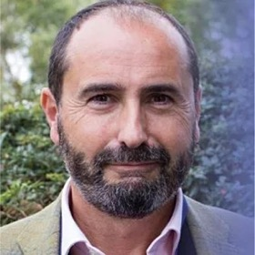
Meet your team.
Stefanie Carr
Ollie Mead
VP of Marketing
VP of Sales

Slide 6
Start with the end in mind.

Slide 7
Who we are…

Slide 8


Slide 9
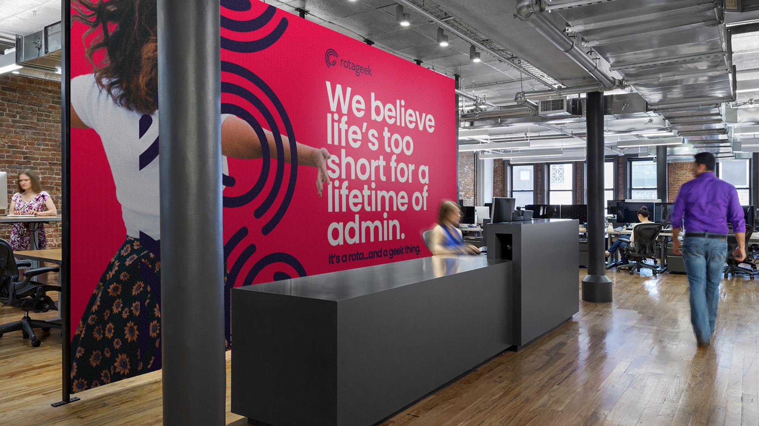

Slide 10
Our history.

Slide 11












Where did we come from?
2009
2013
2014
2020
Rotageek was started to answer the scheduling problem within the A&E of the NHS.
Rotageek began to focus on the retail industry realising they faced similar scheduling challenges as the NHS and their solution could help to solve them
Rotageek signed its first retail customer, O2
Rotageek has seen substantial growth after funding rounds and had built a strong retail customer base, and signed its first NHS Trust.

Slide 12


Where did we come from?
The scope of our solution has expanded beyond simply workforce management and continues to redefine optimisation and fairness.
Today
​Every week we schedule…
1 million hours
Across 130k work shifts
For 40k users

Slide 13
Our partners.

Slide 14





















Our Partners.
Boost your Rotageek deployment through the utilisation of our partner network who provide best-in-class Workforce Management solutions and services:

Slide 15











Our Customers.

Slide 16









Our Customers.

Slide 17
The current landscape.

Slide 18
The current landscape.
Bullet listed
Bullet listed
Bullet listed
Bullet listed
Bullet listed
Bullet listed
Bullet listed

Slide 19
Relaying the prospect challenges.
Bullet listed
Bullet listed
Bullet listed
Bullet listed
Bullet listed
Bullet listed
Bullet listed

Slide 20
Our approach.

Slide 21
Scheduling is inherently complex.
Notes:
Why we exist !
Business requirements:
Forecasted demand
Skill coverage
Budget constraints
Legal compliance:
Working time directive
Break length & timing
Contract obligations
Employee well-being:
Availability
Shift preferences
Weekend distribution

Slide 22
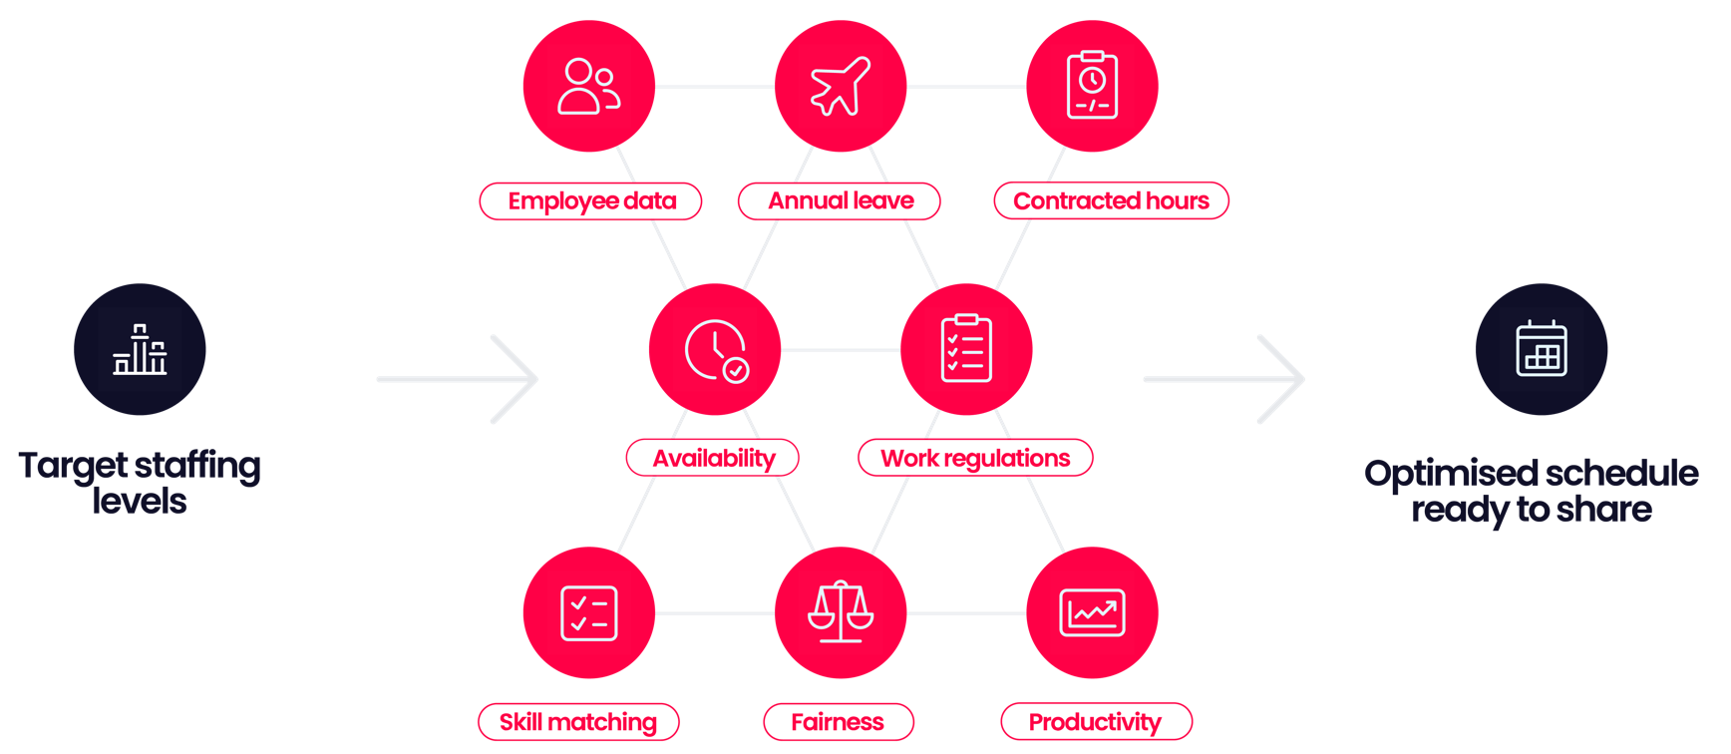

The geeky stuff behind the scenes.
Notes:
To create a truly optimised schedule , you could be required to take all of these things into account
Starting with
Forecasting - Demand-driving data
Basic level we’re talking staffing levels but it could be ny data-point that drives demand for labour, either across a store or a task, so that can be used to accurately forecast future demand.
Rotageek can do this down to the 15-minute interval using a custom-configured machine learning algorithm which takes into account trends and holidays.
Optimisation - Hard and soft constraints weighted depending on importance
Contract hours & availability . Labour-to-demand match , Labour budget, Planned absences, Skill matching, Employee preferences, Break & lunch rules , European Working Time Directive
Fairness – Employee Wellbeing – Weighted to achieve work life balance – Happier Engaged workforces are more productive work forces

Slide 23

The geeky stuff behind the scenes.
With AI and automation at its heart -
Autoscheduler truly optimises schedules by creating and assigning shifts in tandem, generating millions of combinations of schedules and only proposing a final schedule where every shift is assigned to an employee.
Feed in your business rules and data to create a truly optimised schedule ready to share within seconds.
Notes:
To create a truly optimised schedule , you could be required to take all of these things into account
Starting with
Forecasting - Demand-driving data
Basic level we’re talking staffing levels but it could be ny data-point that drives demand for labour, either across a store or a task, so that can be used to accurately forecast future demand.
Rotageek can do this down to the 15-minute interval using a custom-configured machine learning algorithm which takes into account trends and holidays.
Optimisation - Hard and soft constraints weighted depending on importance
Contract hours & availability . Labour-to-demand match , Labour budget, Planned absences, Skill matching, Employee preferences, Break & lunch rules , European Working Time Directive
Fairness – Employee Wellbeing – Weighted to achieve work life balance – Happier Engaged workforces are more productive work forces

Slide 24



Our solution ecosystem.
Forecaster
AI algorithms
Autoscheduler
Optimisation & fairness engine
Demand data
Dashboards
Reports and visualisations
Sales data
Absence management
Holiday, sickness & other absence tracking
Colleague data
Messaging
Top-down messages to 1 or many
Labour budgets
Scheduler
Digital creation tools
Time & attendance
Mobile with geo-fencing & photo-capture
Pay code data
Timesheets
Audit & approve
Your solutions
Optimised WFM
Core WFM

Slide 25

What makes Rotageek different?
01.
02.
03.
04.
05.
06.
We understand complex retail
No Surprises
Customer Led
UK Headquarters
Smaller – more agile
Intuitive & easy to use
Over 60% of our customers are UK in retail. We live and breathe it. Rotageek was created for retail out of the box which makes it quicker and easier to implement as it doesn’t need to be re-configured.
With Rotageek there are no surprises. Upgrades in our solution are included as standard so you’ll always have the best experience of digital scheduling with us and be able to create optimised rotas to meet your changing customer demand.
You’ve heard it before…but our customers really are at the heart of what we do. We’re constantly listening to their needs and wants, so that our solution solves their WFM challenges. Our Customer Success Managers hold quarterly meetings with key stakeholders and we have an instant feedback tool in our solution that all users can access. Not to mention our independently highly rated support and soaring 27.9 NPS score!
Our priority lies here in the UK, with our strong UK customer base, The way we develop the solution, is with UK retail in mind, all product decisions happen here in the UK, with our UK customers firmly in mind.
This isn’t our first rodeo! We will use our years of experience implementing WFM at scale with mid-market and enterprise size retailers to share best practice and do the heavy-lifting. We’ve walked this path many times and have learned from mistakes others have made in the past.
We respect the fact that 99% of our users are going to be store managers and front-line employees. Moving away from spreadsheets, manual processes or legacy systems is a significant change for you, so we appreciate adoption can be tough. Therefore, it makes it even more important that the system you choose is easy on the eye and easy to use.

Slide 26

What makes Rotageek different?
01.
02.
03.
04.
05.
06.
We understand complex retail
No Surprises
Customer Led
UK Headquarters
Smaller – more agile
Intuitive & easy to use
Over 40% of our customers are UK in healthcare. We live and breathe it. Rotageek was created to solve the challenges of rostering in the NHS, meaning it's out of the box and quicker and easier to implement as it doesn’t need to be re-configured.
With Rotageek there are no surprises. Upgrades in our solution are included as standard so you’ll always have the best experience of digital scheduling with us and be able to create optimised rotas to meet your patient needs.
You’ve heard it before…but our customers really are at the heart of what we do. We’re constantly listening to their needs and wants, so that our solution solves their WFM challenges. Our Customer Success Managers hold quarterly meetings with key stakeholders and we have an instant feedback tool in our solution that all users can access. Not to mention our independently highly rated support and soaring 27.9 NPS score!
Our priority lies here in the UK, with our strong UK customer base, The way we develop the solution, is with UK retail in mind, all product decisions happen here in the UK, with our UK customers firmly in mind.
This isn’t our first rodeo! We will use our years of experience implementing rostering in the NHS to share best practice and do the heavy-lifting. We’ve walked this path many times and have learned from mistakes others have made in the past.
We respect the fact that 99% of our users are going to be doctors and NHS employees. Moving away from spreadsheets, manual processes or legacy systems is a significant change for you, so we appreciate adoption can be tough. Therefore, it makes it even more important that the system you choose is easy on the eye and easy to use.

Slide 27
Our solutions.

Slide 28

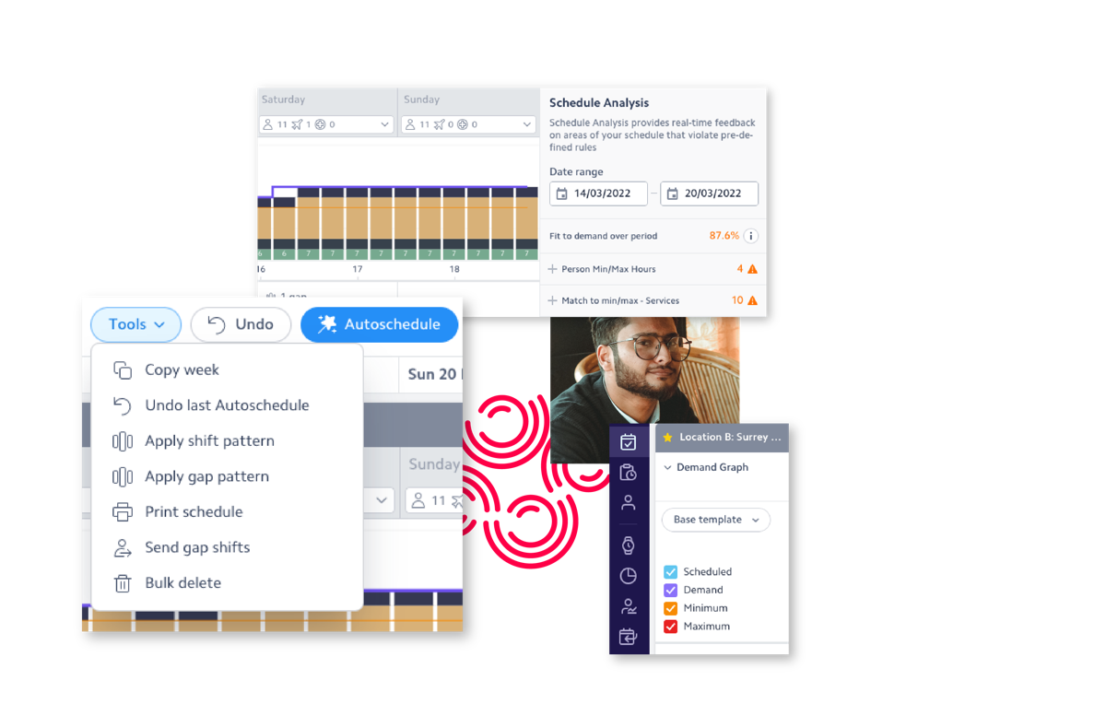
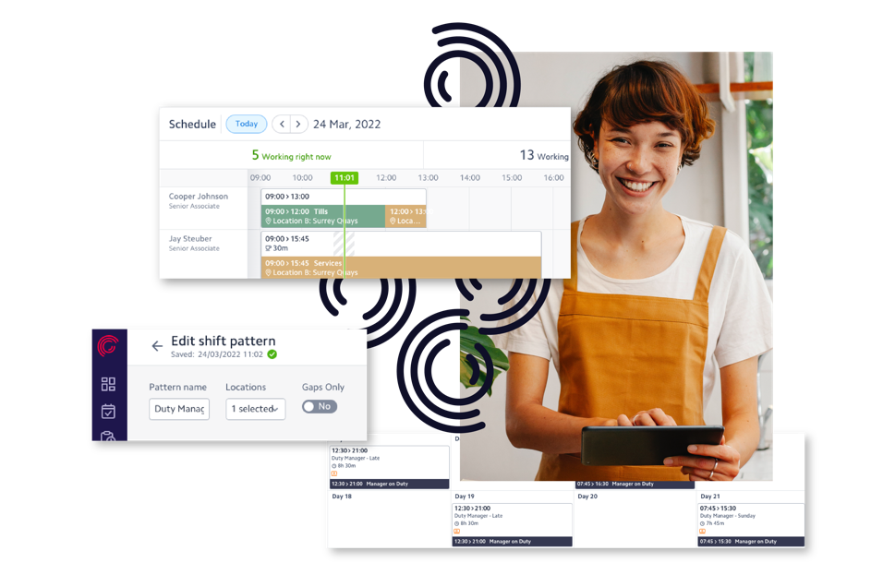
Our solutions.
Create, edit, drag, drop, copy and delete shifts
Configure predefined shifts and create and apply recurring shift patterns
Activities within shifts are linked to staff skill sets
Multi-week view of schedules by store, area or across the business
Timed, untimed, paid and unpaid breaks accounted for within your company policy
Legal compliance, business rule and fairness analyser
Create, broadcast and assign vacant shifts to employees at your own or nearby stores
Dynamic schedule costing with sales-to-labour metrics (e.g productivity, % cost of sales)
1 click schedule creation for as little or as many weeks as needed
Auto-adherence to targets, minimum and maximum staffing levels by activity
Auto-adherence to labour budgets
Auto-adherence to employee contract obligations and legal requirements
Company fairness principles taken into account during auto-creation
Employee working preferences taken into account during auto-creation
Timed break placement optimisation
Auto-create vacant shifts if unable to meet demand
Digital scheduling
Autoscheduling
Build all your workforce schedules and rotas on one intuitive cloud-based platform, taking into account budgets, skills and contractual obligations.
Create the perfect schedule and meet customer demand and employee needs with the click of a button.

Slide 29

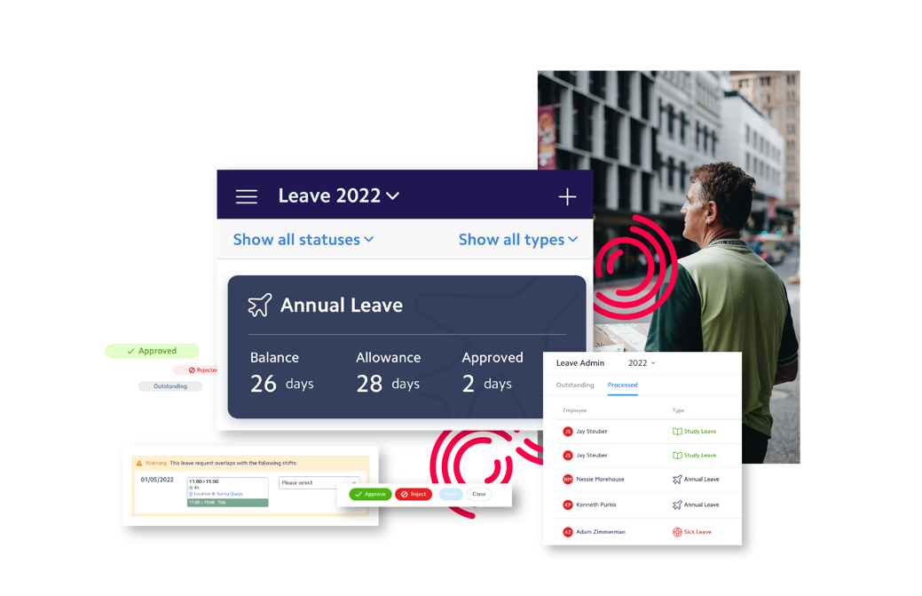
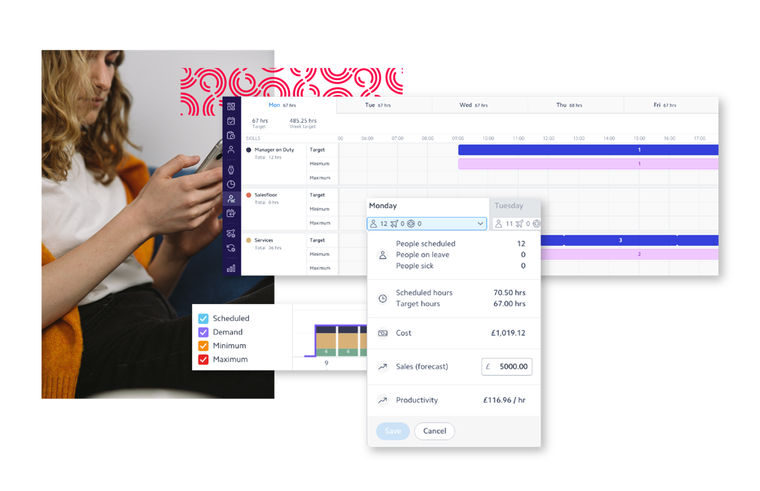
Demand forecasts by task using AI and machine learning algorithms
Demand forecasting using sales, transactions, orders or any time stamped data
Holiday and special event tagging
Bottom-up forecasting which applies labour standards
Top-down forecasting to apply labour budget most effectively
Uses data points defined by you to predict footfall or demand
Annual leave accruals in hours or days
Leave approval hierarchy
Time off in lieu management
Black-out dates & max off restrictions
Absence document storage
Auto-approval of leave within rules
Forecasting
Leave absence
Use data points unique to your business to accurately predict customer demand and create your perfect rotas to match.
Request, approve and track leave and absence for your entire workforce from one solution, and have this information automatically available in our scheduling solutions.

Slide 30

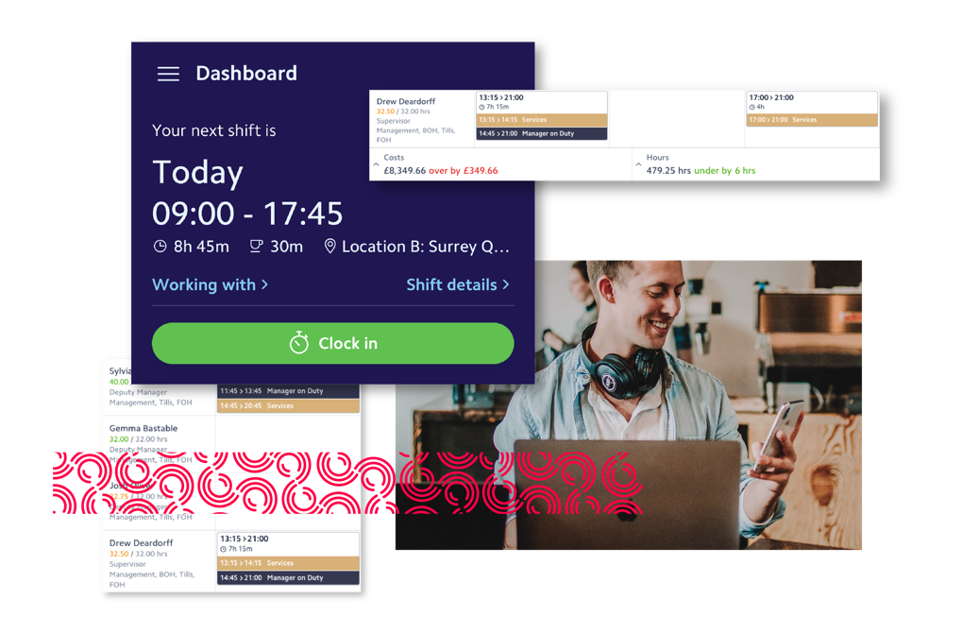

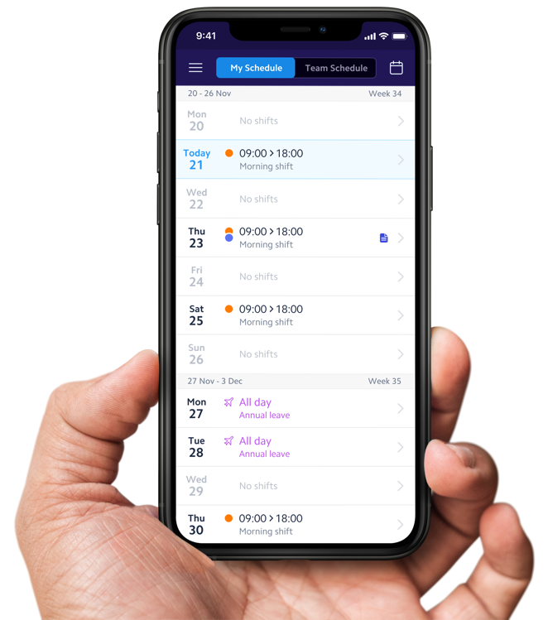
Clocking via employee mobile app, in-store device, or 3rd party timeclock solution
Self-identify reason for clocking outside grace period
Geo-locating, geo-fencing or photo capture at time of clocking
Audit and validate hours worked versus scheduled
Bulk approve timesheet entries
Bespoke pay codes for easy syncing with payroll solutions
Paycode allocation based on labour laws and company policies
Unique rounding rules applied for early and late clock ins and outs
Time & Attendance
Manage gaps, leave, swaps and availability in one seamless interface. Information from your rotas is populated into timesheets to be sent to payroll for accurate processing.

Slide 31
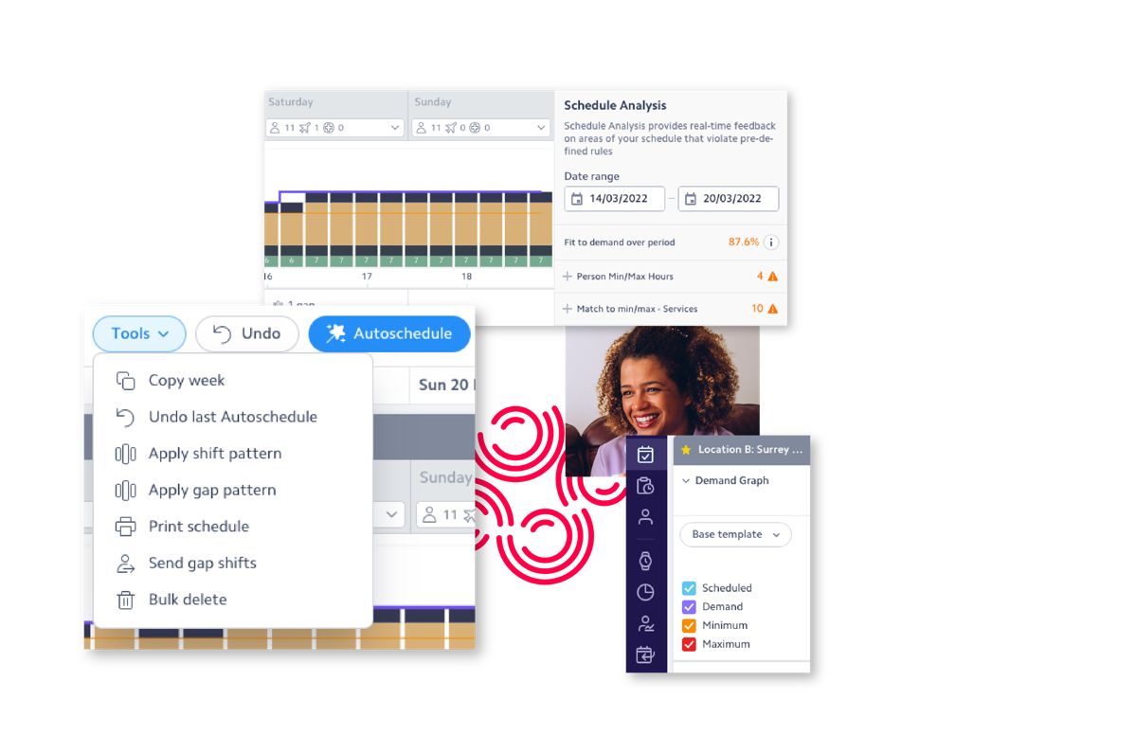
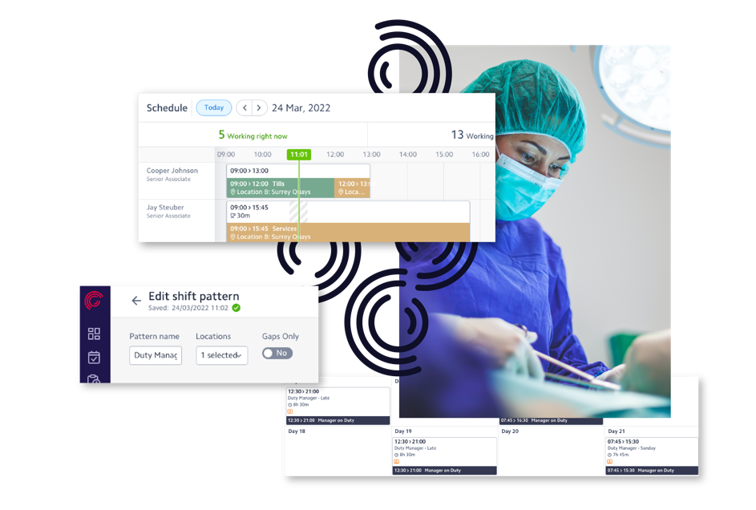
Our solutions.
Create, edit, drag and drop, copy and delete shifts
Configure predefined shifts for easy rostering and create and apply recurring shift patterns
Activities within shifts linked to skills and competencies with multi-activity assignment within a shift
Junior doctor contract and agenda for change compliance analyser
Safe staffing level, fairness and fatigue analysers
Create, broadcast and assign vacant shifts to other employees
Dynamic roster costing for substantive, bank and agency shifts
Real time management dashboard with 15-minute intraday demand graph at location or activity level
1-click roster creation for as little or as many weeks as needed
Auto-adherence to Junior Doctor contract regulations
Auto-adherence to targets, minimum and maximum staffing levels by activity
Auto-adherence to labour budgets
Auto-adherence to employee contract obligations and legal requirements
Fairness principles taken into account during auto-creation
Employee working preferences taken into account during auto-creation
Auto-create vacant shifts if unable to meet demand
Digital scheduling
Autoscheduling
Build all your workforce schedules and rotas on one intuitive cloud-based platform, taking into account budgets, skills and contractual obligations.
Create the perfect schedule and meet customer demand and employee needs with the click of a button.

Slide 32
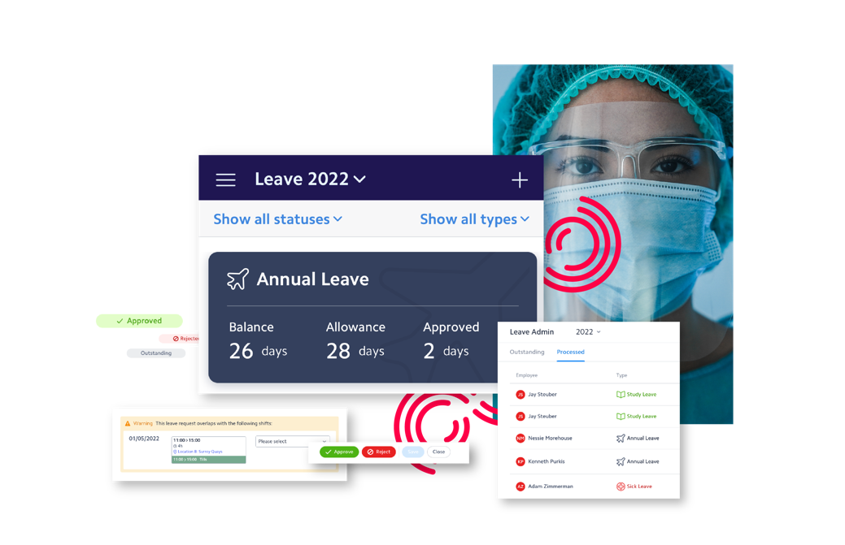
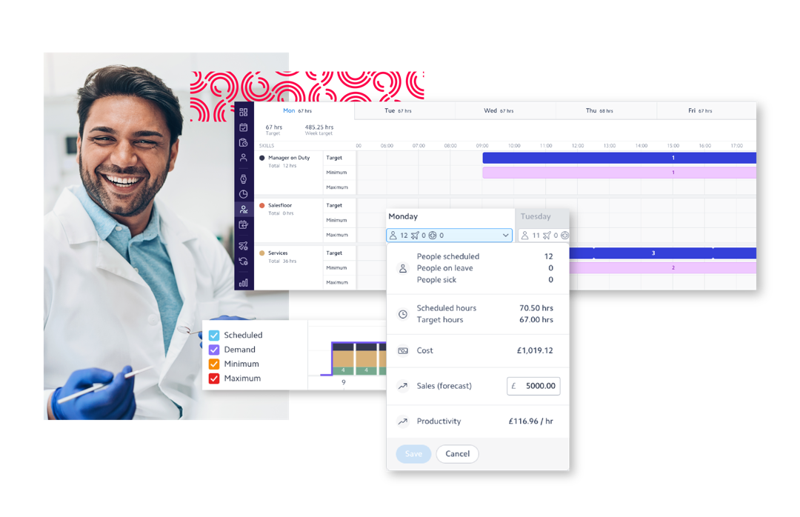
Annual leave accruals in hours or days
Leave approval hierarchy
Time off in lieu management
Black-out dates & max off restrictions
Absence document storage
Auto-approval of leave within rules
Leave admin reporting
ESR integration
Bank & agency solution integration
Patient administration system (PAS) integration
BI warehouse integration
Communication platform integration
Appointment booking integration
Applicant tracking system integration
Other integration via public APIs or flat file via SFTP
Integrations
Leave absence
We advocate interoperability and integrations for intelligent rostering, connecting into critical systems including ESR, HES, bank/locum and HCM solutions.
Request, approve and track leave and absence for your entire workforce from one solution, and have this information automatically available in our scheduling solutions.

Slide 33

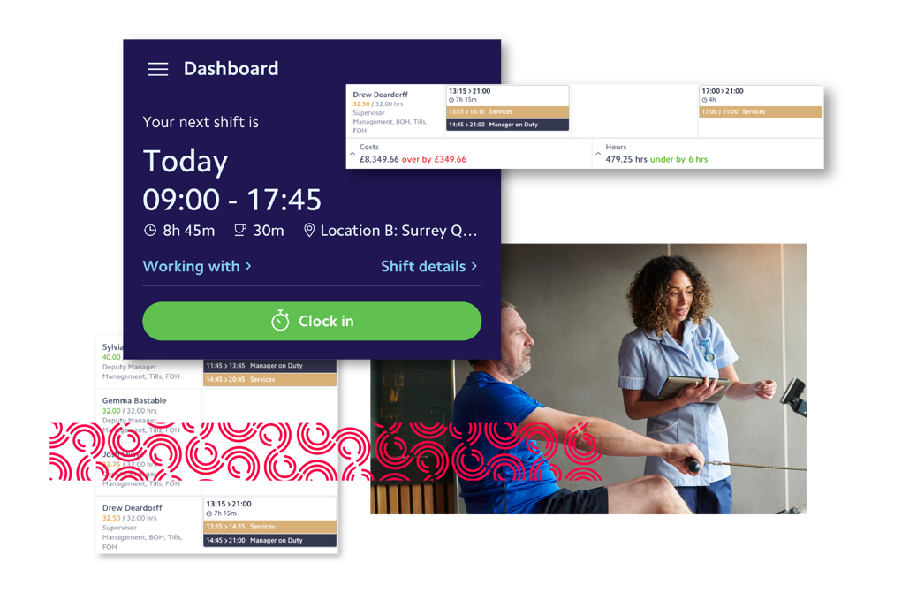
Clocking via employee mobile app, in-store device, or 3rd party timeclock solution
Self-identify reason for clocking outside grace period
Geo-locating, geo-fencing or photo capture at time of clocking
Audit and validate hours worked versus scheduled
Bespoke pay codes for easy syncing with ESR
Paycode allocation based on Agenda For Change
Self-service exception reporting
Flags immediate safety concerns, alerting Guardian of Safe Working, Educational and Clinical Supervisors
Time & Attendance
Manage gaps, leave, swaps and availability in one seamless interface. Information from your rotas is populated into timesheets to be sent to payroll for accurate processing.

Slide 34
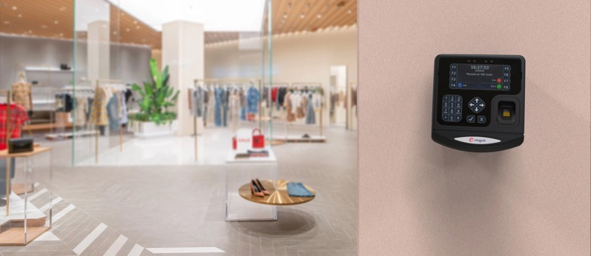
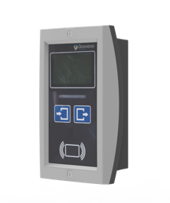
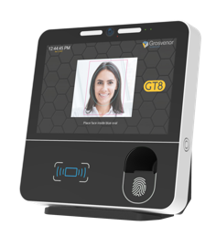
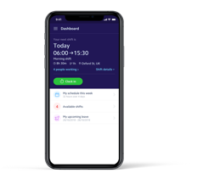
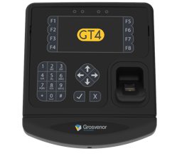
Clocks.
Clock option | Unknown 3rd Party | Rotageek Mobile App | Rotageek IT11 | Rotageek GT4 | Rotageek GT8
Clocking Method | Various Options | Mobile App with Geofencing | RFID Cards | Finger Biometric | Face & Finger Biometric
Communication & Support | Batch API communication only | Directly connected to Rotageek Cloud Service Rotageek Supported
Integration Cost | TBC development cost to connect devices to Rotageek WFM cloud service | Included (no additional cost) | Included (no additional cost) | Included (no additional cost) | Included (no additional cost)
Hardware Cost Individual Unit Price for X units | N/A | N/A | £XX (excludes cost of ID Cards) | £XXX | £XXX
Bi-Direction real time communication between Rotageek cloud service and Clocks
Real Time automated cloud monitoring of all devices to ensure fully operational and s/w updates
Supported and Installed under Rotageek contract
Sourced independently
Fully Integrated Options provided by Rotageek under a single WFM contract

Slide 35
Demo.
Agenda 1
Agenda 2
Agenda 3
Agenda 4
Agenda 5
Agenda 6

Slide 36
Implementation approach.

Slide 37


Our Approach.
Onboarding & Kick Off
Discovery & Design
Build & Test
Train &
Deploy
Meet the team! We assemble to review the scope, agree our success criteria, define roles and responsibilities establish the timeline, identify milestones and build our cadence of project meetings
With the project goals and success criteria firmly in sight we ensure accurate data gathering to understand your requirements for timekeeping, scheduling and integration.
Next we build, test and validate integrations, load the configuration and before we do anything else, we sit down with your experts and review the schedules in a conference room pilot, before we launch to your organisation.
We'll do the heavy lifting by rolling out a phased and tailored training programme to support different user roles across departments. Plus, we have a host of support options including drop-in zoom sessions, in-app chat and knowledge base articles to help with the change management process.
Notes:
I thought it was quite relevant to explore how we manage projects of this nature and size
And the very first thing we do is make no Assumptions – it’s your solution and we’ll set it up in a way that works best for you and understand your specific needs.
We find it helps if the right Stakeholders involved – this includes a key decision maker, a Project Manager, HR and payroll reps, and Operational teams that understand the prison setup and environment.
During the setup, and infact the lifetime of the contract you’ll have access to a dedicated Customer Success Manager. This means less Project Management time required from you, as your Customer Success Manager will keep on top of the project.
The CSM’s role is to engage you as a customer and ensure that you are kept up to date with progress on the implementation.
As your Account Executive I will create a handover document which allows the CS team to set up and configure your Rotageek Platform, Deliver the Proof of Concept and provide Training and support you in any way they can. I'd like to mention, that during the lockdown we’ve become quite familiar with doing remote training to large groups of managers as well as Train the Trainer sessions, and use a variety of online solutions like Zoom, Google Meets and Teams to host these.
Our team will work through the Project Plan and invite you to weekly Project progress calls. The frequency of these calls will reduce to monthly when you’re happy that the solution works and everyone is up to speed.
We’ll create a Success Plan and invite you to a Business Review meeting each quarter.
However, we’re always available outside of the scheduled review meetings to answer any questions you may have along the way.
The discovery typically happens immediately after the contact is signed. Picking up from the Sales team understand the agreed success criteria, and what features are required.
At this stage it’s about capturing information required to set up and configure the system to your needs – we do this via a survey and follow up meeting.
The survey allows you time to engage the right people in advance to get the information, less time of us asking basic questions and more time understanding how your business works.
We use secure sftp for transfer of data, especially where it contains user information but will accept other secure files shared with us.
Customers often join us part way through a leave year and historic data may be required.
We have various import routines for bulk data and there’s some work we do in the background to configure everything else.
From what we have understood around set up requirements, statement of work and timescales, we will produce a Project Plan. This will include some agreed timelines and milestones.
The final step is then be to build your solution.

Slide 38
What we need to make this successful…
Strong Change Management
Clearly Defined Goals & Objectives
Committed Project Sponsor
Detailed Project Schedule
Dedicated Project Team
A committed project sponsor expects the project to succeed and does whatever he or she can do to ensure that success comes to fruition.
Clear, appropriate and timely communication for all stakeholders. what it is, when it is, what’s expected and WIIFM – What’s In It For Me? Don’t worry – we’ve done this before!
What we are going to deliver, in line with stakeholder expectations and with clear business benefit.
A detailed Project Schedule that can be dynamic. This is a constantly changing sector and we need the flexibility to move with it whilst staying focused on our goals and objectives.
A committed project manager and dedicated team. We know this isn’t their day job, so we’ll keep demands to a minimum.
Notes:
I thought it was quite relevant to explore how we manage projects of this nature and size
And the very first thing we do is make no Assumptions – it’s your solution and we’ll set it up in a way that works best for you and understand your specific needs.
We find it helps if the right Stakeholders involved – this includes a key decision maker, a Project Manager, HR and payroll reps, and Operational teams that understand the prison setup and environment.
During the setup, and infact the lifetime of the contract you’ll have access to a dedicated Customer Success Manager. This means less Project Management time required from you, as your Customer Success Manager will keep on top of the project.
The CSM’s role is to engage you as a customer and ensure that you are kept up to date with progress on the implementation.
As your Account Executive I will create a handover document which allows the CS team to set up and configure your Rotageek Platform, Deliver the Proof of Concept and provide Training and support you in any way they can. I'd like to mention, that during the lockdown we’ve become quite familiar with doing remote training to large groups of managers as well as Train the Trainer sessions, and use a variety of online solutions like Zoom, Google Meets and Teams to host these.
Our team will work through the Project Plan and invite you to weekly Project progress calls. The frequency of these calls will reduce to monthly when you’re happy that the solution works and everyone is up to speed.
We’ll create a Success Plan and invite you to a Business Review meeting each quarter.
However, we’re always available outside of the scheduled review meetings to answer any questions you may have along the way.
The discovery typically happens immediately after the contact is signed. Picking up from the Sales team understand the agreed success criteria, and what features are required.
At this stage it’s about capturing information required to set up and configure the system to your needs – we do this via a survey and follow up meeting.
The survey allows you time to engage the right people in advance to get the information, less time of us asking basic questions and more time understanding how your business works.
We use secure sftp for transfer of data, especially where it contains user information but will accept other secure files shared with us.
Customers often join us part way through a leave year and historic data may be required.
We have various import routines for bulk data and there’s some work we do in the background to configure everything else.
From what we have understood around set up requirements, statement of work and timescales, we will produce a Project Plan. This will include some agreed timelines and milestones.
The final step is then be to build your solution.

Slide 39
Implementation timeline.

Slide 40
A Typical Implementation Timeline.
8WEEKS
Phase 1 Deployment
Integration Data Delivery
Solution Sign Off
Core training
Project kick off call
Integration Data Load
Phase 2 Training
Discovery workshop
Phase 1 Training
Phase 2 Deployment
Conference room pilot
8 WEEKS
CHANGE MANAGEMENT
*Not to scale

Slide 41

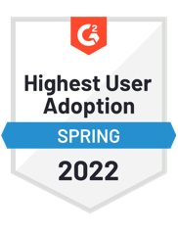
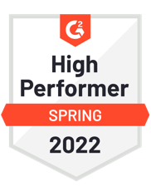



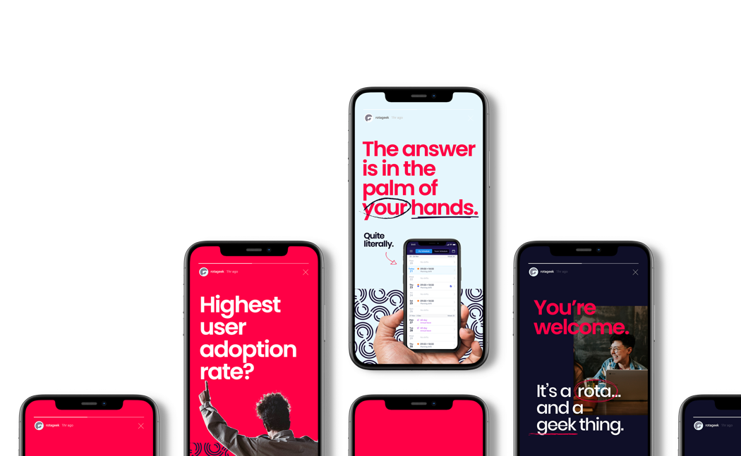

Independent Scores & Awards.
“I find Rotageek so quick and simple. The interfaces are awesome. But the thing I really love about it is the instant support by the chat function”
Curtis J.
Store Leader in UK
“I like the fact that I can see multi site rotas, making it easier to plan my weeks so that I can visit stores when the right people are working”
Gary T.
Area Manager in UK
“I couldn't imagine my working week without Rotageek.”
Phil J. Store Leader in UK
“Rotageek is a huge win for employees!”
Rebecca G.
Store Manager in UK

Slide 42
Case Studies.

Slide 43



Merlin
2000+ employees
Digital Scheduling | Autoscheduling | Leave & Absence | Time & Attendance | Mobile App
The Challenge
Used multiple spreadsheets to schedule their workforce, relying on phone calls, email and Facebook to keep their staff updated
Scheduling was a manual, time-consuming process, vulnerable to human error, particularly during peak and seasonal periods
Used formulas to work out how many staff and with what skills sets were needed during operational hours
Laborious paper-based processes to arrange and view shift swaps and holiday

Slide 44


Merlin
The Results
Using Autoscheduler to create optimised rotas, reducing time spent on this activity by a week a month
Optimised, compliant rotas built with the click of a button
Transparent audit trails that provide a single source of truth
Happy employees with more control over their schedules in the palms of their hands
“Rotageek has definitely helped to make sure we have the right people in the right place at the right time. It's freed up so much time so we're able to spend more time on tills, with customers and have one-to-one time with our teams instead of one-to-one time with the rota.”
Read case study

Slide 45
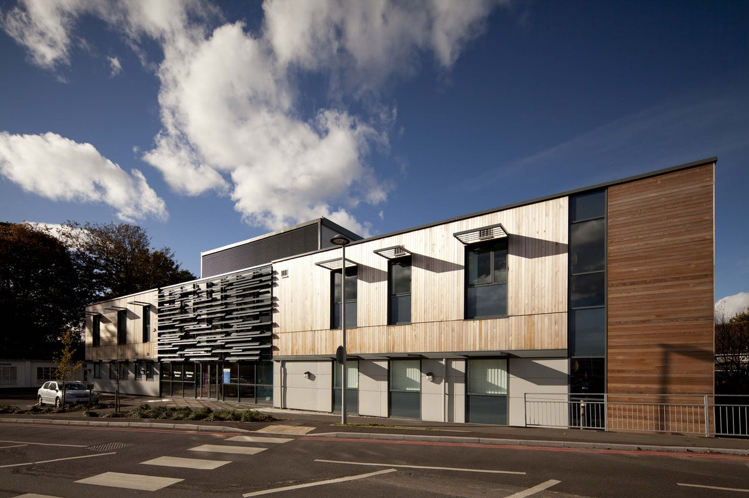

Ashford St Peters Hospital NHS Trust
4500+ employees
Digital Scheduling | Leave & Absence | Time & Attendance | Mobile App
The Challenge
A mismatch of systems that failed to support multiple departments
Little visibility of staffing levels, fill rates and leave requests
Poor retention rates and a lack of flexibility for over 4,500 employees

Slide 46


Ashford St Peters Hospital NHS Trust
The Results
Doubled the pool of available clinicians to more than 5,000 workers
Now able to fill over 90% of vacant shifts (compared to 4% previously)
Doctors can self-roster, swap shifts and input preferences for a better work life balance
“Providing for our patients is our number one priority. Rotageek helps us to do this, plus give our team better access to manage their rota and reduce the effort in maintaining them, while making the most efficient use of our resources. ”
Debbie Beck
Project Manager, NHS Ashford and St Peter’s Hospitals
Read case study

Slide 47

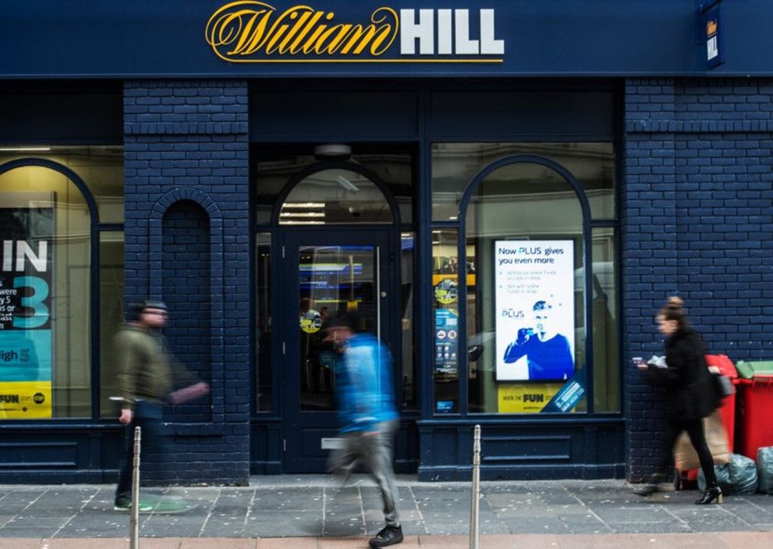

William Hill
7000+ employees
Digital Scheduling | Leave & Absence | Time & Attendance | Mobile App
The Challenge
A needed move from traditional handwritten rotas, to a digital solution as part of organisational change initiatives
Better visibility for HQ, but also for their workforce to help them plan their personal lives better.
A robust digital solution that could handle the complexities of their business with, scheduling 7,000 team members in over 1,400 locations, seven days a week, three hundred and sixty- four days a year.

Slide 48


William Hill
The Results
A trebled success rate on their business KPIs around scheduling their workforce in advance
Their 7000 strong workforce had more notice of their shifts, clear communications and transparency - and no more paper!
More insight on people data for HQ to analyse and improve on
“I’d recommend Rotageek to other businesses on the capability of the product alone, but it’s the quality of service that stands out among relationships. That’s why we’ve introduced other parts of our William Hill family, with teams in our central functions now using Rotageek to manage their own scheduling in our offices and call centres.”
Joe Leith
Retail Productivity Manager, William Hill
Read case study

Slide 49


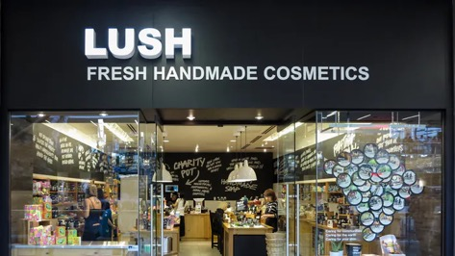
Lush
4000 employees
Digital Scheduling | Autoscheduling | Forecasting | Leave & Absence | Time & Attendance | Mobile App
The Challenge
Using a series of spreadsheets to calculate labour budgets and create schedules
They wanted to take steps to first digitalise manual processes and optimise schedule effectiveness
A robust digital solution that could be deployed in just 1 month across 4000 employees

Slide 50


Lush
The Results
Optimised rotas created in 30 seconds vs 2-3 hours of manual process previously
Decreased their staff costs by 8% with optimised scheduling
Their internal productivity markers saw a 16% increase, accounting for an extra £83K worth of sales
“Flexible scheduling has been made really easy. Before it felt as though we were working with quill and paper and using endless amounts of spreadsheets. I’m hugely excited about the Autoscheduling function. I think for smaller Lush stores this would be absolutely brilliant where there’s only a management team and sales advisors ”
Jennifer Handley
Lush
Read case study

Slide 51
Ongoing Partnership
& Support.

Slide 52






When you join the Rotageek family, we don’t just leave you to it. It’s an ongoing partnership. All users, from HQ to front-line employees are supported and empowered with an online and in-app knowledge base 24/7. And as for our solution? We’re proud to live up to our ‘rota geek’ name and are always innovating with technology to keep your solution relevant, intuitive and future-fit.
39
second average support query response time
No product sprints - we release new
functionality as it’s ready
27.9
net promoter score
Quarterly reviews with dedicated Customer Success Managers
10/10
10/10
10/10
10/10
10/10
"No problem with the app, always keeps me up to date :)"
Because it reminds you of your shift and can easily log in and see the rota a lot quicker than previous"
"The app provides quick updates on work schedules and shifts availability. Reliable and efficient."
It's super easy to use and can sync your mobile phone and to phone calendar"
“I like the way it shows the duty rota"
Notes:
I thought it was quite relevant to explore how we manage projects of this nature and size
And the very first thing we do is make no Assumptions – it’s your solution and we’ll set it up in a way that works best for you and understand your specific needs.
We find it helps if the right Stakeholders involved – this includes a key decision maker, a Project Manager, HR and payroll reps, and Operational teams that understand the prison setup and environment.
During the setup, and infact the lifetime of the contract you’ll have access to a dedicated Customer Success Manager. This means less Project Management time required from you, as your Customer Success Manager will keep on top of the project.
The CSM’s role is to engage you as a customer and ensure that you are kept up to date with progress on the implementation.
As your Account Executive I will create a handover document which allows the CS team to set up and configure your Rotageek Platform, Deliver the Proof of Concept and provide Training and support you in any way they can. I'd like to mention, that during the lockdown we’ve become quite familiar with doing remote training to large groups of managers as well as Train the Trainer sessions, and use a variety of online solutions like Zoom, Google Meets and Teams to host these.
Our team will work through the Project Plan and invite you to weekly Project progress calls. The frequency of these calls will reduce to monthly when you’re happy that the solution works and everyone is up to speed.
We’ll create a Success Plan and invite you to a Business Review meeting each quarter.
However, we’re always available outside of the scheduled review meetings to answer any questions you may have along the way.
The discovery typically happens immediately after the contact is signed. Picking up from the Sales team understand the agreed success criteria, and what features are required.
At this stage it’s about capturing information required to set up and configure the system to your needs – we do this via a survey and follow up meeting.
The survey allows you time to engage the right people in advance to get the information, less time of us asking basic questions and more time understanding how your business works.
We use secure sftp for transfer of data, especially where it contains user information but will accept other secure files shared with us.
Customers often join us part way through a leave year and historic data may be required.
We have various import routines for bulk data and there’s some work we do in the background to configure everything else.
From what we have understood around set up requirements, statement of work and timescales, we will produce a Project Plan. This will include some agreed timelines and milestones.
The final step is then be to build your solution.

Slide 53




The Geeks behind the scenes.
We are loyal to what we do and take pride in our expertise.
We are distinct from the rest.
We have an insatiable need to know everything.
We stick with you ‘til the end…
We have an undying commitment to Workforce Management and we’re fanatical about it. We’re always willing to put in that extra effort.
The customer success team is filled with people who have deep industry expertise.
Even when we’re geeks with a niche for a particular market, chances are that we have developed that preference with a passion.
We delight our customers based on our unique levels of interaction and do things differently.
We seek the company of those who exhibit the same enthusiasm as we do, so we collaborate with fellow geeks across our Rotageek departments to find solutions to our customers needs.
We are agile and can respond to your strategic direction.
The life of a geek revolves around what they love, and we focus on what we’re good at and love doing.
From the outset we’ll ask the right questions to get into the detail of your business needs.
We never stop exploring and always keep ourselves updated about your business challenges.
We know your business will not look the same in 3 or 5 or 10 years, and we don't think our relationship with you should either.
Customer Success is meant to drive change as both of us evolve.
We’ll be sticking to it no matter what happens. We are willing to stand up for our customers and create a lasting partnership.

Slide 54
Living the Geek life.
Engage &
Expand
Evolve & Renew
Onwards and upwards
Continued success
Maintaining that laser focus on business objectives, and with senior stakeholder engagement via regular EBR’s, we’ll keep the business up to date and celebrate success.
Behind the scenes your CSM will be constantly looking for new ways to make you even more successful, feeding new ideas into our product team and eradicating pesky bugs. When it’s renewal time we’ll work with you to ensure you have everything you need for the next chapter.
Project sunsets are the time to set the stage for a long and successful partnership with you. From project review to support handovers & ratifying business objectives, now is the time to build the Success Path.
Regular meeting that add value to our engagement are key, as in the CSM’s role to help you keep your solution up to date and relevant. We’ll also review some key metrics to ensure you are getting the most from us.
Notes:
I thought it was quite relevant to explore how we manage projects of this nature and size
And the very first thing we do is make no Assumptions – it’s your solution and we’ll set it up in a way that works best for you and understand your specific needs.
We find it helps if the right Stakeholders involved – this includes a key decision maker, a Project Manager, HR and payroll reps, and Operational teams that understand the prison setup and environment.
During the setup, and infact the lifetime of the contract you’ll have access to a dedicated Customer Success Manager. This means less Project Management time required from you, as your Customer Success Manager will keep on top of the project.
The CSM’s role is to engage you as a customer and ensure that you are kept up to date with progress on the implementation.
As your Account Executive I will create a handover document which allows the CS team to set up and configure your Rotageek Platform, Deliver the Proof of Concept and provide Training and support you in any way they can. I'd like to mention, that during the lockdown we’ve become quite familiar with doing remote training to large groups of managers as well as Train the Trainer sessions, and use a variety of online solutions like Zoom, Google Meets and Teams to host these.
Our team will work through the Project Plan and invite you to weekly Project progress calls. The frequency of these calls will reduce to monthly when you’re happy that the solution works and everyone is up to speed.
We’ll create a Success Plan and invite you to a Business Review meeting each quarter.
However, we’re always available outside of the scheduled review meetings to answer any questions you may have along the way.
The discovery typically happens immediately after the contact is signed. Picking up from the Sales team understand the agreed success criteria, and what features are required.
At this stage it’s about capturing information required to set up and configure the system to your needs – we do this via a survey and follow up meeting.
The survey allows you time to engage the right people in advance to get the information, less time of us asking basic questions and more time understanding how your business works.
We use secure sftp for transfer of data, especially where it contains user information but will accept other secure files shared with us.
Customers often join us part way through a leave year and historic data may be required.
We have various import routines for bulk data and there’s some work we do in the background to configure everything else.
From what we have understood around set up requirements, statement of work and timescales, we will produce a Project Plan. This will include some agreed timelines and milestones.
The final step is then be to build your solution.

Slide 55
ROI & Costs.

Slide 56


Rotageek & XXX.
Today.
Your current landscape:
A modern, intelligent, easy to use staff scheduling system capable of efficiently and fairly scheduling your staff
Ease of timesheet and attendance logging
Forecast staffing needs
Managers scheduling to a budget
Reduction in overall operating costs
Having an overall view of all stores
Integration with your existing software
Tomorrow.
The future with Rotageek
A modern, intelligent, easy to use staff scheduling system capable of efficiently and fairly scheduling your staff
Ease of timesheet and attendance logging
Forecast staffing needs
Managers scheduling to a budget
Reduction in overall operating costs
Having an overall view of all stores
Integration with your existing software

Slide 57
Pricing.
One-time Fees
Description | Item | Quantity | Price
Implementation services: Project management and configuration | £3850.00 | 1 unit | £3850.00
Professional services: Training delivery & support | £6750.00 | 1 unit | £6750.00
SUBTOTAL |  |  | £10,600.00
Annual recurring Fees
Description |  |  | Price
User license fees: Digital rostering & mobile app |  |  | £10,080.00
SUBTOTAL |  |  | £10,080.00
TOTAL | £20,680.00

Slide 58
Questions?

Slide 59
Next steps & agreed actions.
Bullet listed
Bullet listed
Bullet listed
Bullet listed
Bullet listed
Bullet listed
Bullet listed
Bullet listed
Bullet listed

Slide 60
It’s a rota…and a geek thing

